Slide 1
Secure Socket Layer

Slide 2
Introduction- Web Security
Web Security – means providing data that is transmitted over the network
Client server interaction- client sends request and server provides services. For this we use one protocol called SSL protocol
SSL- using this we can provide a security for the data over the network that is transmitted between web browser and the server.
SSL protocol includes: SSL Record protocol, Hand shake protocol, change cipher spec protocol and Alert Protocol. So this is called the SSL protocol stack.
This is implemented above the TCP/IP and just below the HTTP

Slide 3
Real time example
If you want to send your credit card details to web-server over internet, if you do not use Secure Socket Layer (SSL), any third party computer can grab your credit card details using hacker software. If you use SSL, it provides protection to your data and that your data is submitted to web servers securely.

Slide 4
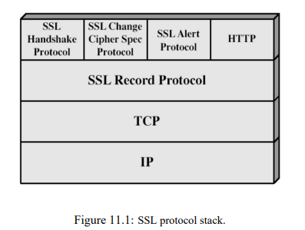
SSL protocol stack

Slide 5
The SSL record protocol, which is at a lower layer and offers services to these three higher level protocols.
1. Handshake Protocol.
2. Change Cipher Spec Protocol.
3. Alert Protocol.

Slide 6
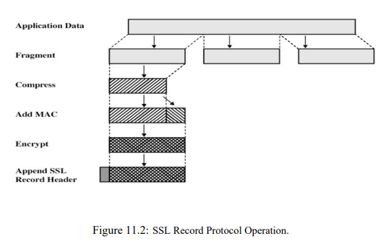
a) SSL Record Protocol
This protocol provides two services for SSL connections:
Confidentiality - using conventional encryption.
Message Integrity - using a Message Authentication Code (MAC).
MAC is added using a secret key.
Encryption using Symmetric Encryption

Slide 7
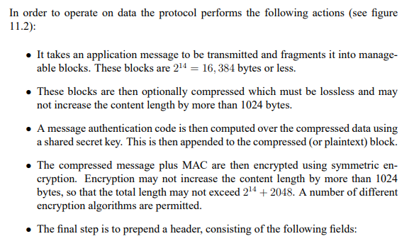

Slide 8
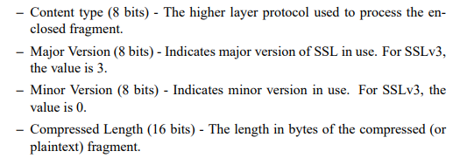

Slide 9
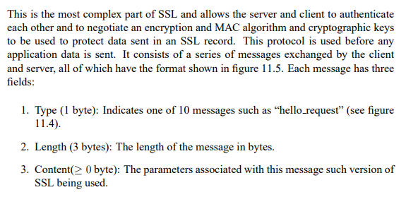
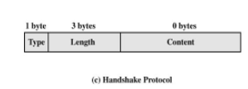
b) SSL Handshake Protocol

Slide 10
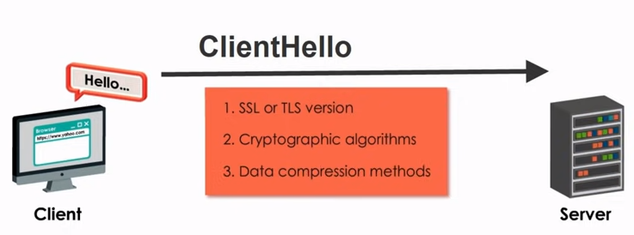
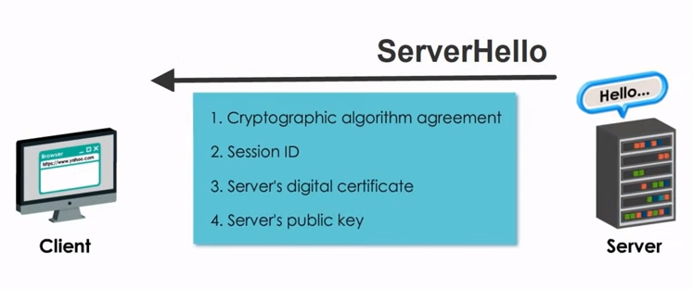

Slide 11
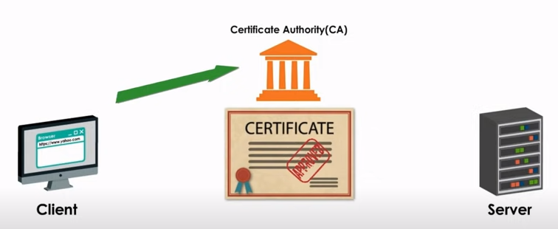
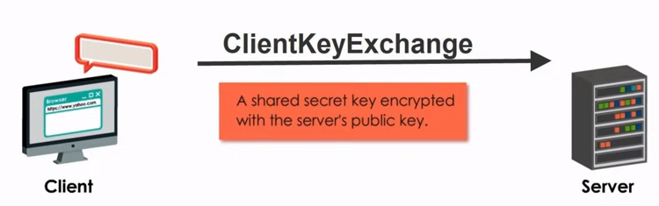

Slide 12
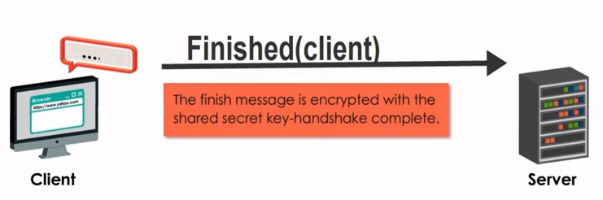
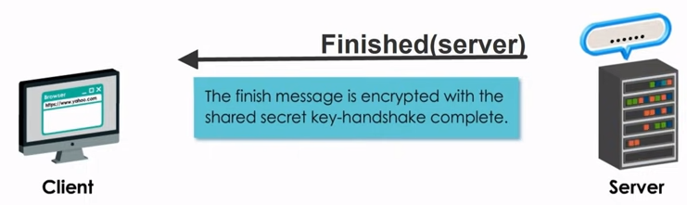

Slide 13
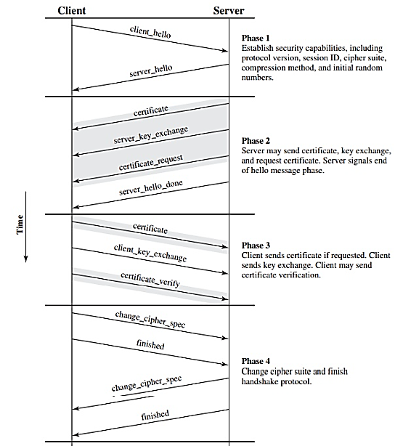

Slide 14
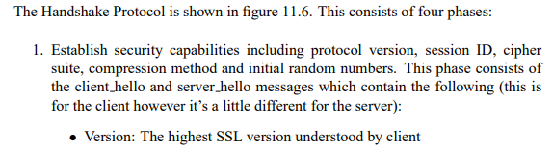
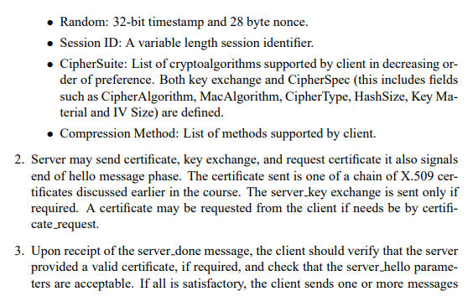

Slide 15
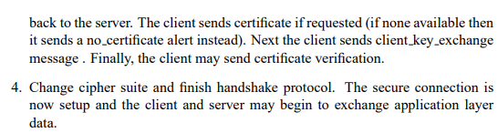

Slide 16
Firewalls
It is a network hardware or software device.
All the data passes through the firewall.
Firewall protect the computer from internet hackers.
After examining the data, firewall either passes or block the data.
Eg gate keeper

Slide 17


Slide 18
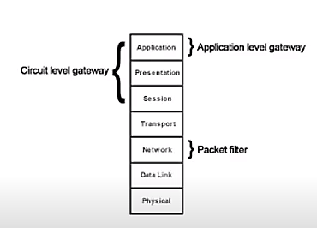
Types of Firewall
Packet filtering
Application Proxy firewall
Circuit level gateway

Slide 19
Packet Filtering
It works in the network layer of the OSI Model. It applies a set of rules (based on the contents of IP and transport header fields) on each packet and based on the outcome, decides to either forward or discard the packet.
Packet filter firewall controls access to packets on the basis of packet source and destination address or specific transport protocol type. It is done at the OSI (Open Systems Interconnection) data link, network, and transport layers. Packet filter firewall works on the network layer of the OSI model.
Packet filters consider only the most basic attributes of each packet, and they don’t need to remember anything about the traffic since each packet is examined in isolation. For this reason, they can decide packet flow very quickly.

Slide 20
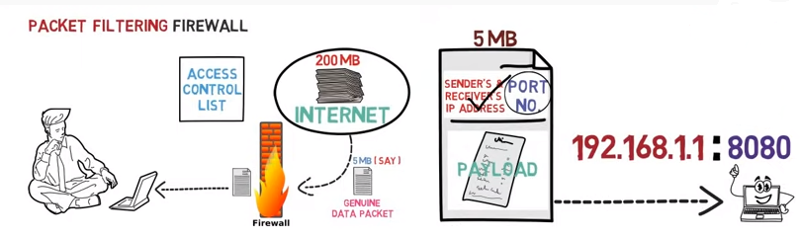

Slide 21

Packet filtering firewall does not check the payload(that is the information). So any hackers can send malicious information.

Slide 22
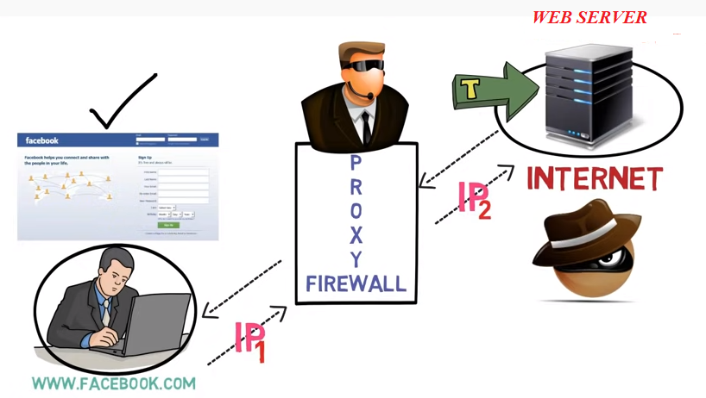
Application / Proxy Firewall

Slide 23
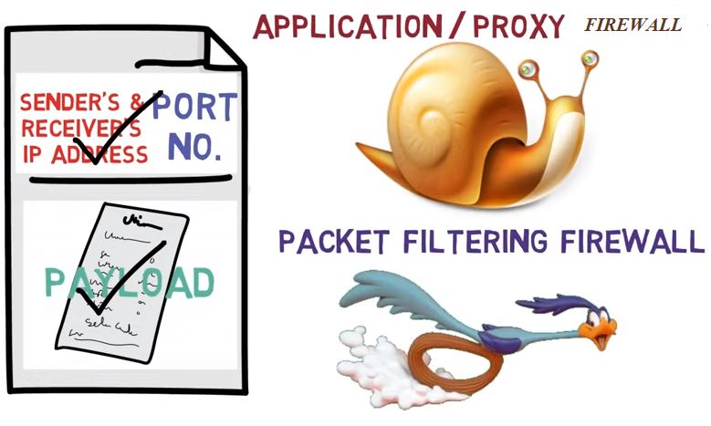
Proxy server does not let the web server the origin of the request.
So that information is not known to the hacker. It checks the payload as well. Its very slow compared to packet filtering firewall.

Slide 24
Circuit level gateway firewall
It is a type of firewall that provides session level control over network traffic.
Similar in operation to packet filtering routers, circuit level gateways operate at a higher layer of open systems interconnection (OSI) reference model protocol stack.
Circuit-level gateways are host-based and reside on individual clients and servers inside the network, rather than on a dedicated machine as they do with other types of firewalls.
Circuit-level gateways examine incoming Internet Protocol (IP) packets at the session-level – transmission Control Protocol (TCP) or User Datagram Protocol (UDP) – and act as relays by handing off incoming packets to other hosts.

Slide 25
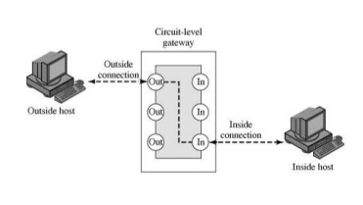
Circuit-level gateways are rarely used as a stand-alone firewall solution; instead, they are typically used in combination with application layer proxy services and packet filtering features in dedicated firewall applications.

Slide 26
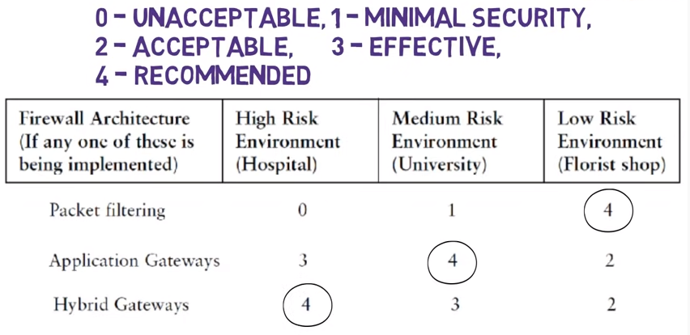

Slide 27
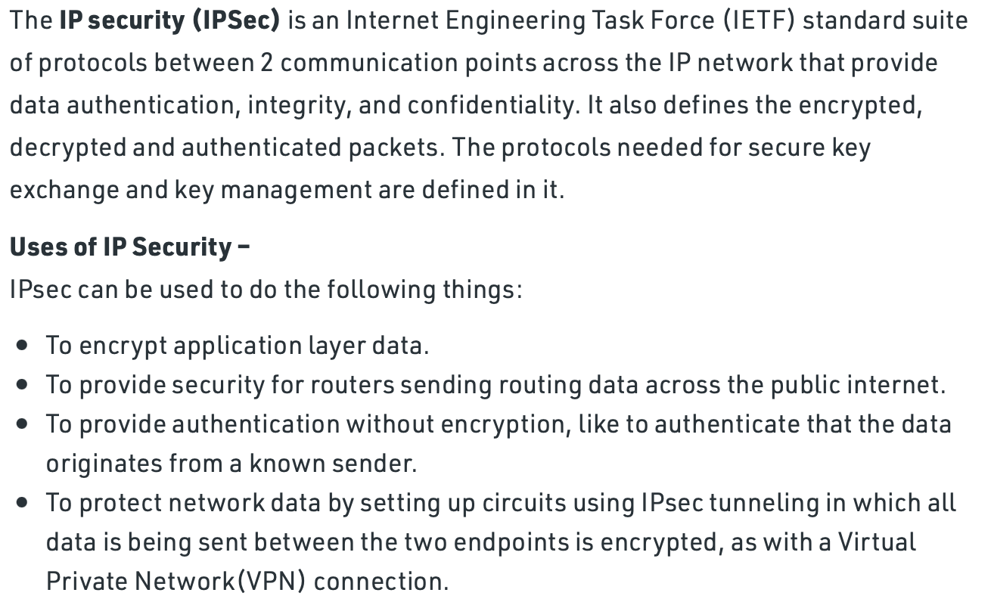
IPSec (IP Security)

Slide 28
IPSec
IPSec uses two distinct protocols: Authentication Header (AH) and Encapsulating Security Payload (ESP).
The AH protocol provides a mechanism for authentication only. ESP can be used with confidentiality only, authentication only, or both confidentiality and authentication.
IPsec Protection Protocols. AH provides data integrity by using an authentication algorithm. It does not encrypt the packet. ESP typically protects the packet with an encryption algorithm and provides data integrity with an authentication algorithm.

Slide 29
